Slide 1

Big Data Tool: Apache Spark
Name: Naif Alqahtani

Slide 2
Framework Overview: Apache Spark
Purpose:
Large-scale data processing
Batch + streaming + ML + SQL in one unified framework
Architecture:
Distributed computing engine based on RDDs + DataFrames
Master–worker cluster model (Driver + Executors)
Optimized execution using Catalyst optimizer + Tungsten engine
Capabilities:
Distributed ETL pipelines
Window functions, joins, aggregations
Machine learning
Fault tolerance & lazy evaluation

Slide 3
Why Spark?
Why Spark for this Assignment?
Dataset is multi-table → Spark handles distributed joins perfectly
We needed advanced features (such as, partitioning)
Why Spark over alternatives?
Faster than Hadoop MapReduce (in-memory execution)
More mature + scalable than Dask for big data
Easier and more Python-friendly than Flink
Supports SQL, ML, and streaming in one tool
Used in real industry environments (Databricks, AWS EMR)

Slide 4


Installation:
Environment:
Google Colab
PySpark
KaggleHub for downloading dataset
Steps:
!pip install pyspark kagglehub pandas
Create SparkSession
Connect Spark UI using ngrok (Need Token)
Load the six CSVs into Spark DataFrames
Challenges:
Spark UI access required ngrok auth token
Multiple CSVs with different schemas → careful joining
Managing missing values across many table

Slide 5
Experimentation:
Used a Multi-table dataset for company employees
Workloads Performed:
Multi-table distributed joins
ETL: cleaning, type casting, feature engineering
Analytical tasks:
Salary by country, department, gender
Promotion impact
Experience vs salary
YOY salary change
Ranking top earners (window functions)
Advanced Spark Features used:
Window functions
Parquet partitioning (by year)
Predicate pushdown
Shuffle partition tuning
Caching experiments

Slide 6
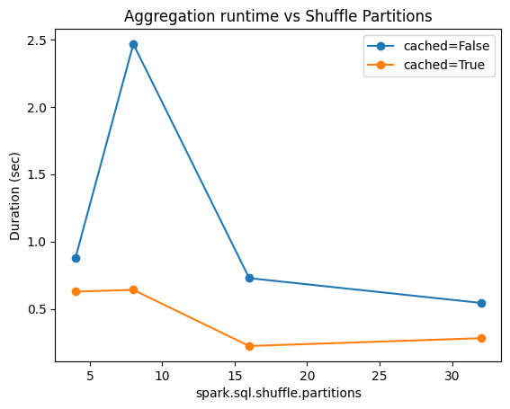
Results:
Key Findings:
Large salary differences across countries & departments
Promotions correlate strongly with salary growth
Senior employees show higher YOY changes
Team size affects department-level salary trends
Performance Results
Parquet partitioning → much faster filtered reads
Caching → improved repeated groupBy operations
Too few partitions → Low parallelism
Too many partitions → Overhead increases.

Slide 7
Critical Analysis:
Strengths:
Extremely scalable
Unified framework (SQL, ML, streaming)
Excellent for ETL and analytics
Optimized execution engine
Limitations:
Requires careful memory management
Shuffle operations can be expensive
UI access in Colab requires tunneling
Overkill for small data

Slide 8
Thank you for listening

